Slide 1
Welcome to
Our Sunday School
We’ll start at 9:07
visit OurSundaySchool.com for more about our class

Slide 2
Today’s class (pages 28-31)
Philippians 1:4b-5

Slide 3
Philippians 1:3-5 (CSB)
I give thanks to my God for every remembrance of you, always praying with joy for all of you in my every prayer, because of your partnership in the gospel from the first day until now.

Slide 4
Today’s class (pages 28-31)
Philippians 1:4b-5

Slide 5
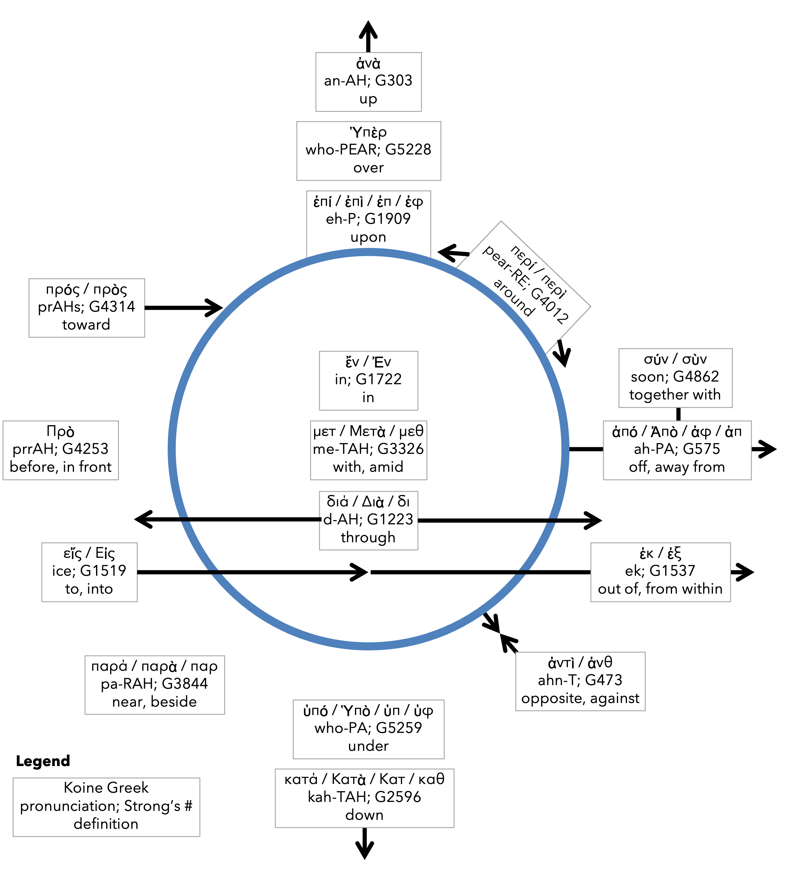
Preposition circle (page 11)

Slide 6
Today’s class (pages 28-31)
Philippians 1:4b-5

Slide 7
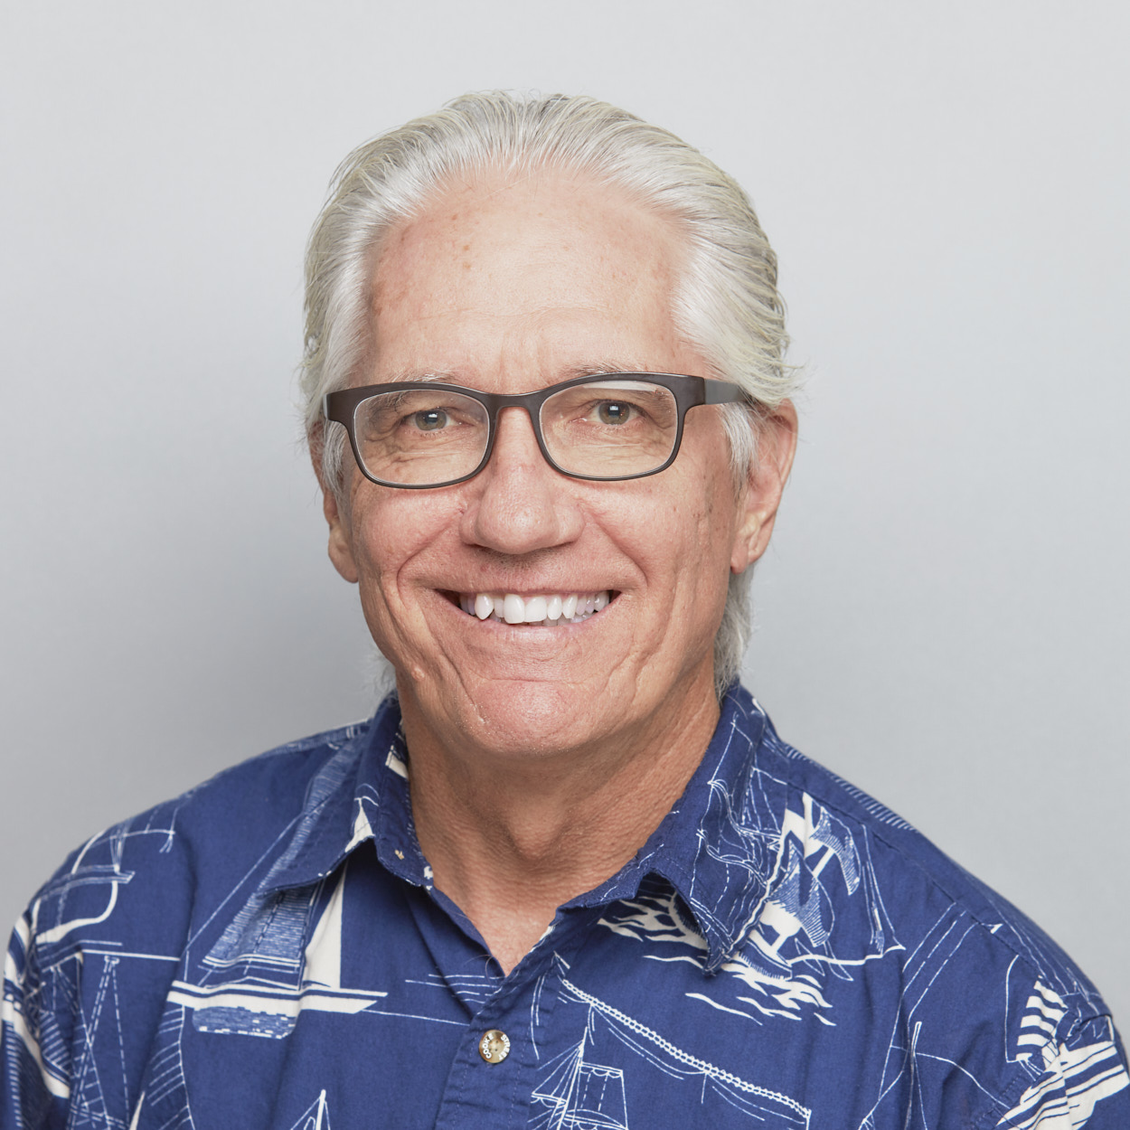
Dr. Joe Hellerman
Euaggelion also appeared in Roman imperial propaganda, where an emperor’s birthday was associated with the dawn of a new era…

Slide 8
Dr. Joe Hellerman
[One] inscription… reads, in reference to Augustus (who is also called “savior”), “the birthday of the god was the beginning of good tidings (euaggelion) for the world.”

Slide 9
Today’s class (pages 28-31)
Philippians 1:4b-5

Slide 10
Prayer Time
Write down your prayer requests (on the Weekly Update or in the comments)
Lean in, engage, and pray for someone not with you
Go worship

